Slide 1
Windows Configuration Management with Puppet
Why let the Linux admins have all the fun?
Notes:
Often it seems that all the conversations around configuration management only mention Linux.
The reality is that you can apply the same techniques to Windows and even use a single toolset across both.
A quick note: Don’t worry about copying things off the screen. This slide deck and some related files are posted online and I’ll provide a link on the last slide.

Slide 2
Gene Liverman
SRE @ Puppet
Formerly SysAdmin @ University of West Georgia
Windows, Linux, Mac, & Solaris
Storage, Firewalls, Load Balancers, etc.
Notes:
Started at Puppet in April with a focus on our hardware and virtualization infrastructure
Prior to that I was a SysAdmin and Systems Architect
I managed servers with varying OS’s, worked in AD regularly, and managed our data center.
I ran Puppet Open Source in production for about 2 ½ years to help manage all of it.

Slide 3
Agenda
Better together
Chocolatey
Patching
Modules
Packer
Notes:
This talk is an introduction to why you might want to use Puppet in a Windows environment.
It’s broken up into a few categories that cover the aspects I’ve found most useful over the last few years

Slide 4
Better Together
(DSC, Hyper-V, SCCM, WMI) + Puppet
Notes:
Puppet can supplement the tools you may already be using.
Taking a ”better together” approach to means there’s less of a learning curve and you get the best of everthing.

Slide 5
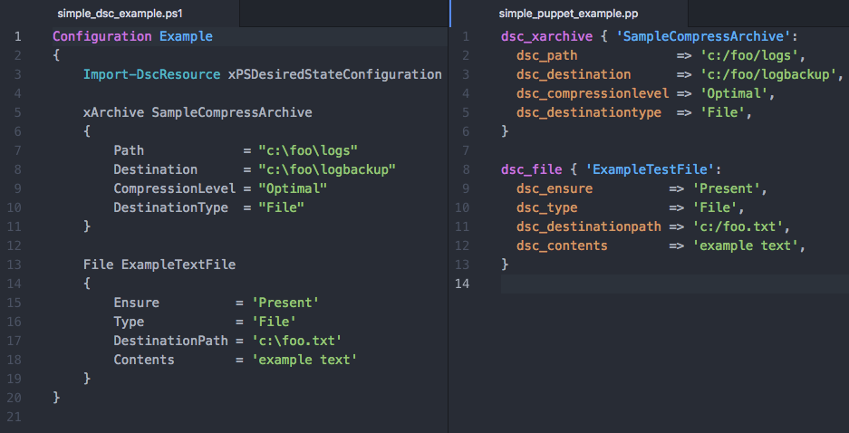
DSC in PowerShell vs DSC via Puppet
Write less code to do the same thing
Notes:
Many Windows admins are using PowerShell’s Desired State Config to make their lives easier.
Puppet fully supports DSC and has a very similar syntax.
This example shows how you can translate DSC resource into Puppet resources.
It also highlights a few key points:
Similar syntax – no big learning curve
Boilerplate removed
Fewer lines of code

Slide 6
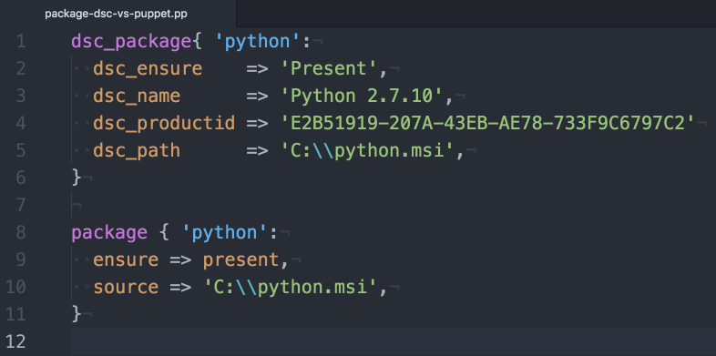
Migrate resources to Puppet
Get the same result fewer lines of code
Notes:
There’s nothing wrong with just doing a 1:1 translation of DSC to Puppet.
That said, there are some things Puppet just does better than DSC alone.
Package installation is one of those things.
Both of these resources do the same thing but the native Puppet is much simpler to write and maintain.
In particular, Puppet doesn’t require you to know the product ID which means you don’t have to hunt it down before writing or updating your code.

Slide 7
Puppet + DSC
DSC doesn’t do everything Puppet does
No real reporting
No rebooting as needed
No package management
Doesn’t keep historical data on changes performed
DSC does cover things Puppet doesn’t
Hyper-V is one example
Notes:
DSC reporting is basically hunting through event logs.
Anyone who’s worked with Windows knows that installing things generally means a reboot is needed.
DSC doesn’t provide a graceful way to handle this.
DSC lets you install MSI’s but stops way short of really managing your packages.
All that said, there are things that DSC does that Puppet doesn’t. Hyper-V is a prime example of this.

Slide 8
Puppet, DSC, & Hyper-V
xVHD: VHDs
xVhdFile: files or directories in a VHD
xVMDvdDrive: DVD drives attached to a VM
xVMHost: Hyper-V host settings
xVMNetworkAdapter: VMNetadapters on a VM or the management OS
xVMProcessor: VM processor options
xVMSwitch: virtual switches
The xHyper-V module
Notes:
DSC provides a wealth of resources for managing Hyper-V.
Combining these with Puppet allows you to manage as little or as much of your Hyper-V environment right along side the servers being deployed into it.

Slide 9

You'll likely run into a situation where either Puppet or DSC doesn't cover the entirety of the problem all by itself. Instead of trying to make one solution fit all, you can mix and match them.
Paraphrasing the “Managing Windows with Puppet Enterprise” white paper
Notes:
(example on next slide)

Slide 10
Puppet, DSC, & Hyper-V
Typical network: VM → virtual switch → physical switch(s)
VM: DSC’s xVMNetworkAdapter
virtual switch: DSC’s xVMSwitch
physical switch(s): Puppet modules for Arista, Cisco, Cumulus, Juniper
End-to-end network management
Notes:
One example of mixing and matching could be the network layer of your Hyper-V environment.
DSC provides a means of managing all the virtual components.
Puppet provides a way of managing many of the physical components
By putting your DSC code in Puppet you can manage the entire setup in one place

Slide 11
Layering Puppet Enterprise on top of DSC
Gain rich management capabilities including:
Node classification
Status of nodes across your infrastructure
Global access control
Authentication can be via AD credentials
Tracking and reporting change
This simplifies compliance auditing

Slide 12
Puppet + WMI
Integrate with existing SCCM
Query client configuration such as location
Starting out with Puppet custom facts
https://glennsarti.github.io/blog/puppet-ruby-facts/
Module: thoward/sccm_application
Installs or uninstalls packages advertised by SCCM
Notes:
Facts are pieces of info about each system puppet runs on such as IP address, MAC address, host name, and OS.
Since facts can be used as variables in Puppet manifests it can be useful to create custom ones specific to your needs.
In addition to things that can be discovered about a server by interrogating it custom facts allow you to leverage info in systems outside of Puppet such as SCCM.
An example of this would be querying SCCM for the location of a server and using that as part of a decision-making process in your Puppet code.
There is a great walk through for getting started with custom facts written by one of our Windows developers that I recommend checking out later.
Facts are not the only integration point.
A community member named Trevor Howard wrote a module that installs or uninstalls packages advertised by SCCM.

Slide 13
Chocolatey
aka apt-get / yum for Windows

Slide 14
Package management for Windows
What is Chocolatey?
Builds on NuGet
Provider for PackageManagement (aka OneGet) in WMF 5
Public repo: chocolatey.org
Private repo: Chocolatey Server
Great for internal software packages
Module: chocolatey/chocolatey_server
Notes:
Chocolatey is a Windows package manager that can be used to manage third-party and internal software and their dependencies.
Chocolatey builds on the NuGet to provide an easy-to-use interface for users and admins
Windows Management Framework 5 can use Chocolatey as a provider for the PackageManagement
Publicly available packages can be browsed and installed from chocolatey.org
You can also run your own NuGet server to distribute internal software
There is a Puppet module that makes it super easy to setup a server if you don’t already have one

Slide 15
Common use cases for Chocolatey
FOSS Puppet agent
Monitoring & Backup agents
Log shipping
PowerShell / WMF, .Net, NodeJS
Browsers & plugins
Chrome & Firefox
Adobe, Flash, Java
Utilities such as Git, 7-Zip, & Notepad++

Slide 16
Patching
WSUS + strict change windows + Puppet
Notes:
Many Windows shops find that WSUS alone doesn’t allow them to fully automate patching.
This is especially true if you have strict change windows in which patches must be applied.
Lets take a look at how Puppet can help with this.

Slide 17
Patching scenario
Install & manage Chocolatey
Install NuGet package provider for PowerShell
Install PSWindowsUpdate PowerShell module
Define a maintenance window
Configure automated reboots during the maintenance window
Install / upgrade PowerShell and WMF during the maintenance window
Configure WSUS-related settings on the client
Apply all non-interactive updates
Notes:
(demo is next)

Slide 18
Demo Time: Code Sample
A Puppet manifest for patching Windows
Notes:
(walk through win_patching.pp in Atom)
(video on next slide)

Slide 19
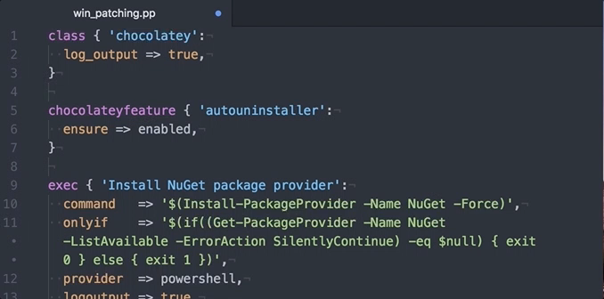
Code sample (video)

Slide 20
Modules
Common tasks made easier and repeatable
Notes:
You’ve heard me mention modules a few times already so lets take a look at what they are and how they can help you.

Slide 21

Puppet Modules
Modules are self-contained bundles of code and data. These reusable, shareable units of Puppet code are a basic building block for Puppet.
https://forge.puppet.com
Notes:
Puppet modules are basically reusable and sharable chunks of Puppet code.
The Puppet for is where most modules are shared and acts as a central repository.

Slide 22
Module: puppetlabs/windows
This module acts as a pack of the Puppet Forge's best Windows content.
Vox Pupuli, voxpupuli.org
puppet/download_file
puppet/windows_env
puppet/windowsfeature
Puppet, puppet.com
puppetlabs/acl
puppetlabs/chocolatey
puppetlabs/dsc
puppetlabs/iis
puppetlabs/powershell
puppetlabs/reboot
puppetlabs/registry
puppetlabs/stdlib
puppetlabs/wsus_client
Notes:
Installing the windows module will pull in variety of great modules from a diverse group of module authors, including Puppet.
Vox Pupuli is a collective of 30 module, tooling, and documentation authors who work together on on 131 different repositories.
(highlight what these modules do)

Slide 23
Modules for common Windows tasks
A sample of what’s on the Puppet Forge
Backups:
thespain/veeamagent (WIP)
FOSS Puppet:
theforeman/puppet
Logs:
genebean/nxlog
puppet/windows_eventlog
Monitoring:
genebean/zabbixagent
icinga/icinga2
puppet/nsclient
sensu/sensu
Others:
puppet/sslcertificate
puppet/windows_firewall
puppetlabs/azure
puppetlabs/aws
Notes:
Just to be transparent, the genebean modules are some of the ones I’ve written.
windows_eventlog - manage each of the Windows event logs, including the size, rotation and retention
nsclient - Installs and manages the NSClient monitoring agent
sslcertificate - install and remove your certificates on Windows machines

Slide 24
Packer
Templated virtual machines
Notes:
When writing and testing code its helpful, and sometimes necessary, to have a sample of the target operating system.
Packer lets you define what those sample machines look like in a concise way and then build it for use on a variety of platforms including local and remote virtualization environments and cloud providers.

Slide 25
Packer resources
Blogs:
http://www.hurryupandwait.io/blog/creating-windows-base-images-for-virtualbox-and-hyper-v-using-packer-boxstarter-and-vagrant
Templates:
https://github.com/puppetlabs/puppetlabs-packer
https://github.com/mwrock/packer-templates
Packer: https://www.packer.io
Notes:
If you want to get started with Packerized Windows boxes then you should check out this blog post.
You can find some sample templates in these two repositories to give you an idea of how you might want to set yours up.
The second repo is the one referenced in the blog post.

Slide 26
What we talked about
DSC, WMI, SCCM
Package management with Chocolatey
Patching and rebooting during change windows
Managing common tasks with Puppet modules
Building images with Packer
Notes:
To wrap up, we talked about …

Slide 27
References and resources
Blog posts on Windows from Puppet:
https://puppet.com/blog-tags/powershell-dsc
https://puppet.com/blog-tags/windows
Blog post on custom facts: https://glennsarti.github.io/blog/puppet-ruby-facts/
Chocolatey: https://chocolatey.org
PackageManagement (aka OneGet): https://github.com/OneGet/oneget
PowerShell xHyper-V: https://github.com/PowerShell/xHyper-V
Puppet Forge: https://forge.puppet.com
White paper:
https://puppet.com/resources/whitepaper/managing-windows-with-puppet-enterprise

Slide 28
Puppet Community
Hang out with other Puppet users and get help when you’re stuck:
Slack: http://slack.puppet.com
Q&A: http://ask.puppet.com
IRC: #puppet or #puppet-dev on Freenode
Google group: http://groups.google.com/group/puppet-users
Puppet User Groups (PUGs): https://puppet.com/community/user-groups
https://puppet.com/community

Slide 29
Go have some fun automating your Windows configurations
Let Puppet do the repetitive things while you play with new stuff

Slide 30
Gene Liverman
gene.liverman@puppet.com
genebean.github.io/talks
github.com/genebean
@technicalissues
Notes:
Feel free to reach out if you have any questions

